Slide 1
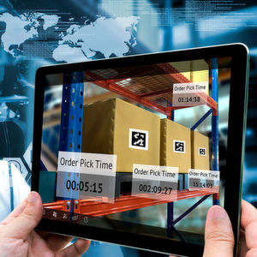
SUSTAINABLE SUPPLY CHAIN SOLUTION ON NESTLE

Slide 2
INTRODUCTION
sustainable supply chain integrates environmentally and socially responsible practice into the entire supply chain lifecycle from raw material sourcing to end-of-life product disposal.
Considerable influence on the environment due to its vast supply chain.
This project aims to align the environmental impacts of nestles operations and generate long-term economic benefits.

Slide 3
OBEJECTIVE & SCOPE
Recycling and reuse : implementing circular economy principles to reduce waste.
Green procurement : souring material from environmentally responsible suppliers.
Waste reduction : minimizing waste through better design production processes and packing.
The scope of the simulation covers three critical area :
Recycled materials.
Reducing packaging waste.
Optimizing transportation.

Slide 4
IMPROTANCE OF SUSTAINABILITY
Addresses environmental concerns such as resource depletion pollution and climate change .
Enhance brand reputation and customer loyalty.
Meets regulatory and compliance requirements.
Driver innovation and operational efficiencies.

Slide 5
CHALLENGES AND SOLUTIONS
Overcoming initial cost barriers through long-term saving .
Addressing resistance to change with education and incentives.
Navigating complex regulations and standards with strategic planning.

Slide 6

RECYCLING MATERIAL
organic waste recycling : composing food scraps and yard waste to enrich soil and reduce land fill burden .
Glass recycling : melting down used glass to create new glass products minimizing landfill wase .

Slide 7

REDUCING PACKAGING WASTE
Biodegradable packing : utilizing materials that decompose naturally without harming the environment .
Eco-friendly : switching to sustainable materials such as paper cardboard or plant based plastics .

Slide 8
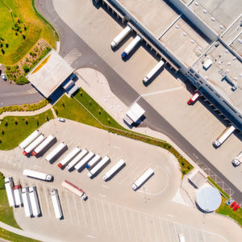
OPTIMIZING TRANSPORTATION ROUTE
eco-driving practices : training drivers in fuel-efficient driving techniques.
Route planning : utilizing advanced software to determine the most efficient delivery route.

Slide 9
CONCLUSION
Sustainable supply chain solutions are vital for addressing environmental and social challenges while driving operational efficiency. By integrating practices like recycling materials, reducing packaging waste, and optimizing transportation, companies can significantly reduce their ecological footprint. Embracing these strategies not only benefits the environment but also enhances brand reputation, meets regulatory requirements, and fosters innovation. As we move towards a greener future, continuous improvement and adaptation to emerging trends will be key. Let’s commit to implementing these solutions and leading the way in sustainability, ensuring a healthier planet for future generations.

Slide 10
THANK YOU
GOPATHI SAI SUDHA
gopathisaisudha@gmail.com

